Slide 1

Back Education
Presented by Achieva Health

Slide 2
Contents
Introduction
Anatomy Review
Proper Posture
Back Injuries
Injury Prevention
The Role of Exercise

Slide 3
Introduction
80% of population experiences low back pain.
Healthcare workers have highest incidence rate of back injury among all professions, next to only construction workers.
Injury often caused by:
Poor posture.
Faulty body mechanics.
Stressful living and working habits.
Loss of strength and flexibility.
General decline of physical fitness.

Slide 4
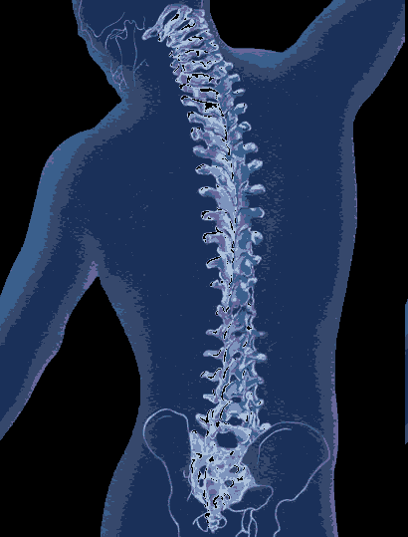
Functions of the Spine
Supports the trunk and head.
Allows freedom of movement.
Protects the spinal cord.
Acts as a shock absorber.

Slide 5
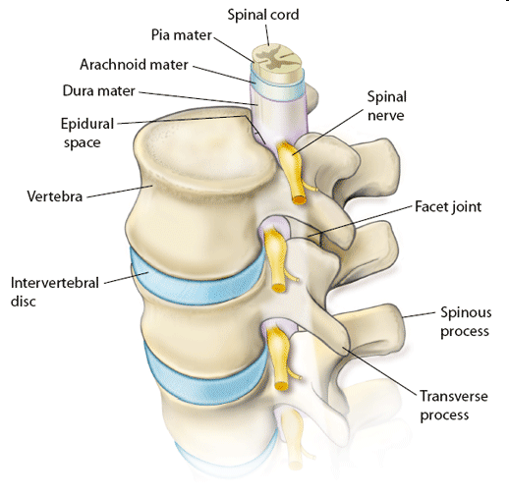
Anatomy Review
Vertebrae
Intervertebral Discs
Ligaments
Muscles
Nerves & Spinal Cord

Slide 6
Bones of the Vertebral Column
Vertebral Column
Extending from the skull to the tip of the coccyx, the adult spinal column is 72-75 cm in length.
Formed by 33 vertebrae and 23 intervertebral discs, it is a flexible column that serves several functions.

Slide 7
Vertebrae (33)
24 moveable, 9 fixed.
5 sections based on location and similar attributes:
7 Cervical, 12 Thoracic, 5 lumbar, 5 Sacral and 4 Coccygeal.
5 Sacral are fused to form the Sacrum and 4 Coccygeal are fused to form the Coccyx (tailbone).
Consist of the vertebral body and vertebral arch:
Body is anterior.
Arch is more complex with projections for muscle and ligament attachment.
Facet joints connect vertebrae.

Slide 8
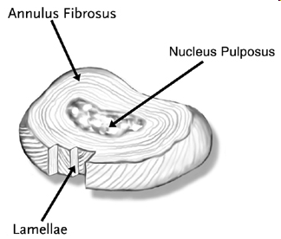
Intervertebral Discs
Moveable discs of fibrocartilage between vertebrae:
Outer ring of strong Annulus Fibrosis.
Inner core of the Nucleus Pulposus – a jelly-like substance.
Lamellae form interior.
Provide shock absorption.
Withstand compression.

Slide 9
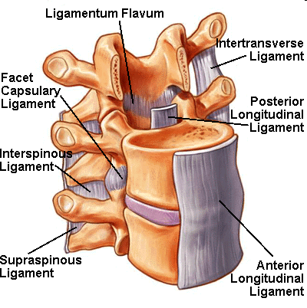
Spinal Ligaments
Densely packed collagen fibers.
Provide structural stability.

Slide 10
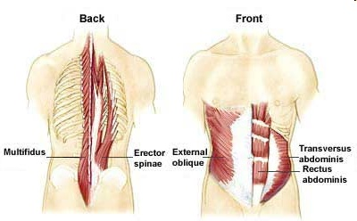
Core Muscles
Abdominals and Erector Spinae support spine.
Key postural muscles.

Slide 11
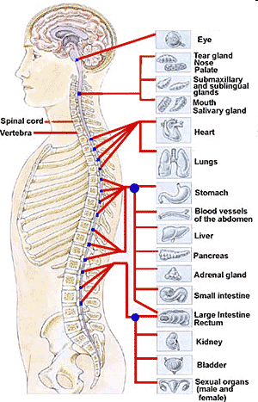
Spinal Cord & Nerves
Spinal cord travels down from brain in vertebral canal.
Motor nerves travel out from brain, through spinal cord to body.
Sensory nerves travel up from body, through spinal cord to brain.

Slide 12
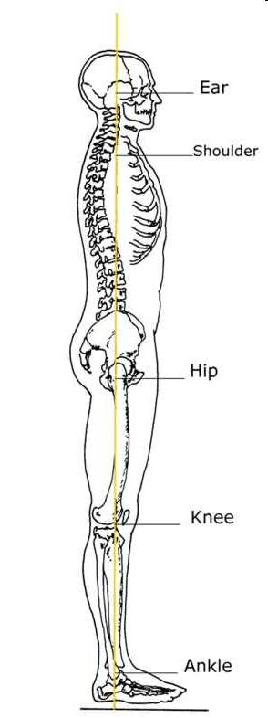
Proper Posture
Requires:
Alignment of vertebrae.
Strength and flexibility of muscles and ligaments.
Proper body mechanics.
Even distribution of body weight.
Maintenance of natural spine curvatures.

Slide 13
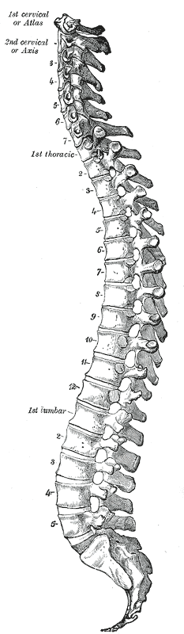
Proper Posture
Involves spine in Double “S” Curvature:
Provides flexibility and absorbs shock.
Evenly distributes weight.
4 Curves:
Cervical and Lumbar = Lordotic Curve
Thoracic and Sacral = Kyphotic Curve

Slide 14
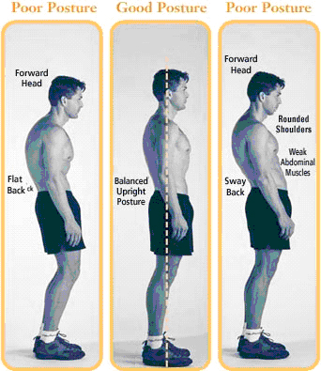
Proper Posture – Standing
Shoulders, hips and ankles are level.
Knees slightly bent.
Spine in Double “S” Curve.
Chin up, shoulders back, knees relaxed.
Even distribution of weight through feet.

Slide 15

Proper Posture – Sitting
Firm surface, straight back chair.
Sit far back in chair with feet flat on floor.
Ankles, knees, hips at 90° angles.
Avoid prolonged sitting.

Slide 16

Proper Posture – Sleeping
Firm mattress.
Sleep on side with pillows between knees.
Sleep on back with pillow under knees.
Avoid sleeping on stomach.

Slide 17
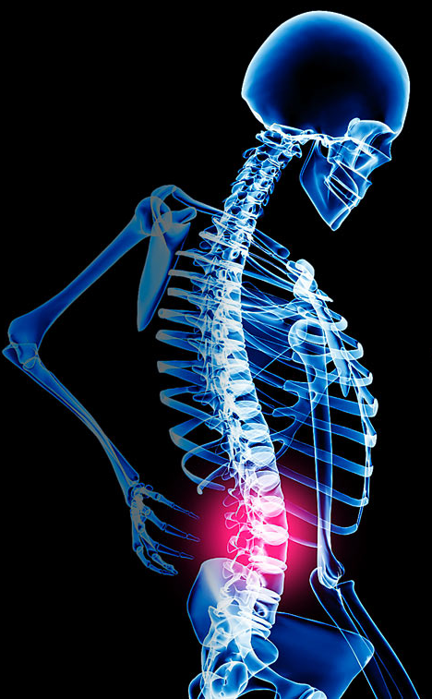
Back Injuries
Spinal Abnormalities
Fractures / Osteoporosis
Disc Injuries
Arthritis / Ligament Sprains
Muscle Strains
Nerve Damage

Slide 18
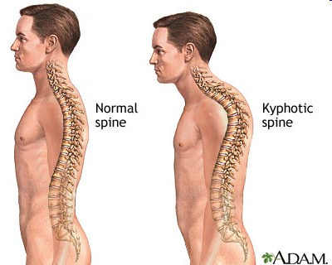
Spinal Abnormalities
Kyphosis
Increased thoracic curvature – hunchback.
Often due to osteoporosis / age / medications.

Slide 19
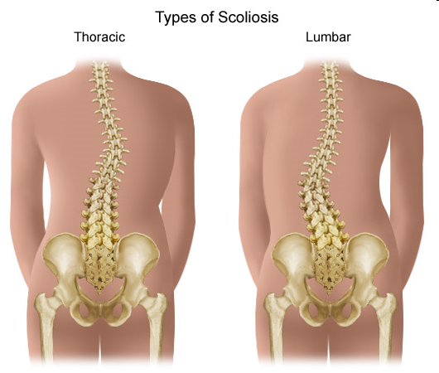
Spinal Abnormalities
Scoliosis
Lateral curvature of the spine.
Structural = due to abnormal vertebrae and does not disappear with bending.
Functional = usually due to muscular imbalance and disappears with forward bending.

Slide 20
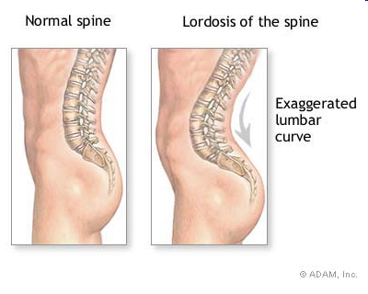
Spinal Abnormalities
Lordosis
Exaggerated lumbar curve.
Caused by weakened abdominal muscles and tight back muscles.
Causes posterior stress and low back pain.

Slide 21
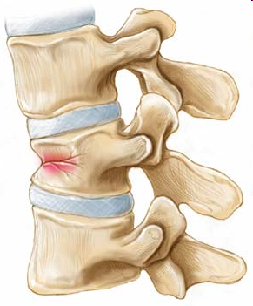
Vertebral Fractures
Compression fractures due to trauma or osteoporosis.
Osteoporosis = loss of bone mineral density leading to weakness in bones.
Causes loss of height, chronic back pain, breathing difficulties, kyphosis.

Slide 22
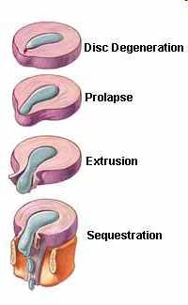
Disc Injuries
Prolonged loading of spine can rupture fibers of the disc and lead to degeneration.
Incomplete Herniation:
Protruding disc
Nucleus begins to leak through annulus.
Prolapsed disc
Completely through fibers.
Complete Herniation:
Extruded disc
Material moves into the Spinal Canal.
Sequestered disc
Material separated from the disc.

Slide 23
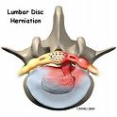
Disc Injuries (Continued)
Lumbar disc injuries most common:
L₄-L₅ and L₅-S_{1.}
Symptoms include:
sudden aching in the back or neck.
Inability to straighten back without extreme pain.
Numbness, tingling, or weakness in one or both arms or legs.
Pain that radiates into the legs.
Muscle weakness.
Bladder problems.

Slide 24
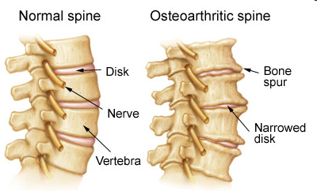
Arthritis
Caused by aging, improper posture, poor body mechanics.
Characterized by degeneration and wearing away of intervertebral discs.
Leads to bone on bone contact.
Osteophyte formation possible.

Slide 25
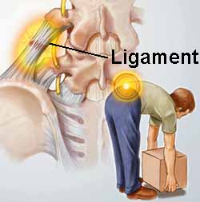
Ligament Sprains
Caused by improper posture, poor body mechanics or injury.
Leads to pain, tenderness, stiffness and weakness.

Slide 26
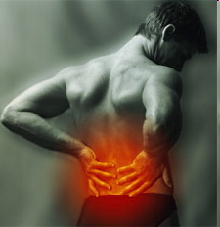
Muscle strains
Caused by improper posture, poor body mechanics, strength and flexibility imbalances or injury.
Leads to pain, tenderness, stiffness and weakness.

Slide 27
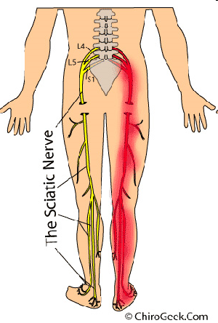
Spinal Cord Injury
Caused by improper posture, poor body mechanics or injury.
Can cause feelings of pain, numbness, tingling, burning.
Difficult to diagnose as symptoms may be felt at area different from injured site.
Eg. Sciatica

Slide 28
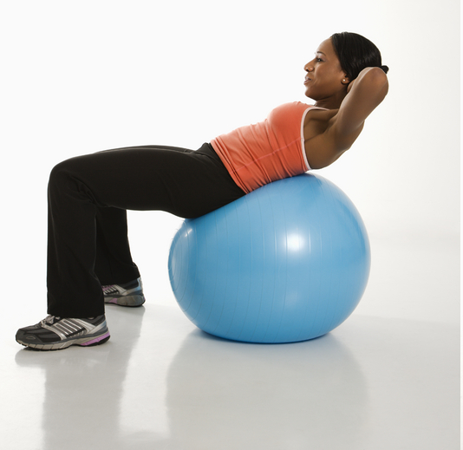
Injury Prevention
Maintaining Proper Posture
Correcting Posture
Proper Body Mechanics
5 steps for Safe Lifting
The Role of Exercise

Slide 29
Maintaining Proper Posture
Correct posture should be a way of life.
Promote a short rest period daily:
Lie as flat as possible with all joints out straight.
Avoid sitting in low soft chairs:
Ensure there is adequate back rest, hips at right angles, feet flat on the floor.
Stand as tall as possible.
Change positions often.

Slide 30
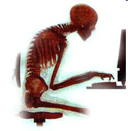
Correcting Posture
Functional Abnormalities can be corrected by:
Stretching tight musculature:
Anterior Deltoids, Pectoralis Major and Minor.
Strengthening weak musculature:
Latissimus Dorsi, Posterior Deltoids, Abdominals and External Rotators.
Paying close attention to habits:
Carrying purse / backpacks.
Standing posture.
Prolonged sitting.
Sleeping habits.

Slide 31
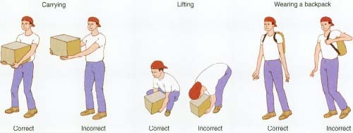
Proper Body Mechanics
Important to maintain proper posture throughout day to avoid injury.
Plan your lifts and the path you wish to follow in advance.
Avoid reaching and twisting.
Ask for assistance with heavy loads:
Eg. Two-person transfer or mechanical lift.

Slide 32
Safe Lifting Mechanics
Stand close to the object:
Avoid reaching.
Use a wide base of support:
Keep feet hip width apart for stability.
Use large muscle groups to bend down towards the object:
Engage abdominals and stand in proper posture.
Use legs and gluteals to crouch and stand up.
Perform a slight pelvic tilt to support low back.
Keep shoulders back, chin up, spine in neutral.

Slide 33
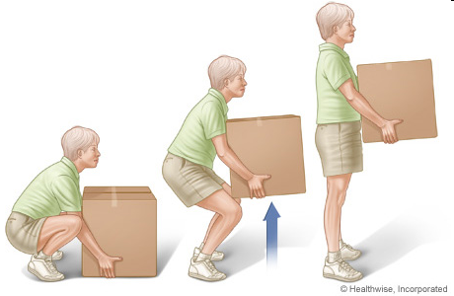
Safe Lifting Mechanics
Lift the object, holding the object close to your body:
Use key muscle groups, keep spine neutral.
Pivot with your feet in the direction you wish to go:
No twisting, set down the load carefully.

Slide 34
The Role of Exercise
Exercise helps prevent back injury by:
Encouraging proper posture.
Maintaining strength and flexibility.
Improving balance and coordination.
Exercise and Physiotherapy imperative to treating existing low back pain and / or injury.
Programs should work towards:
Relieving muscle tension.
Restoring motion and balance.
Developing muscular strength, endurance and cardiovascular fitness.

Slide 35
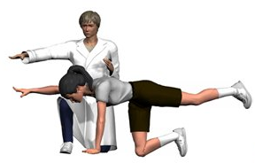
Injury Rehabilitation
Without activity:
Muscle and bone atrophy.
Loss of strength and endurance.
Loss of Range of Motion.
Aerobic de-conditioning.
Immobilize for as little as possible.
Engage in active program of stretching, strengthening and aerobic activity:
Start slowly and progress over time!

Slide 36
Low Back Pain Management
Acute low back pain (less than 3 months):
Reduce exercise and treat pain.
Resume exercise as soon as possible.
Chronic low back pain (greater than 3 months):
Usually not due to tissue injury and thus exercise continuously.

Slide 37
Exercise Components
Strength:
Abdominal and low back strengthening (1-3 sets, 10-15 reps, 2-4 days/week).
Promote muscular symmetry.
Flexibility:
Any ROM exercises that do not increase low back pain, holding each stretch for 10-15 seconds, most days per week.
Aerobic:
Focus on aerobic conditioning for health – minimum 30 minutes per day at a moderate intensity, most days of the week.

Slide 38
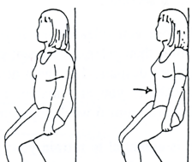
Pelvic Tilt
Sit in a chair, or when driving, or at work in a standing position.
Engage abdominals by flattening your lower back against back of chair or wall if standing.
Hold for 5 seconds.
Release and repeat 5 times.

Slide 39
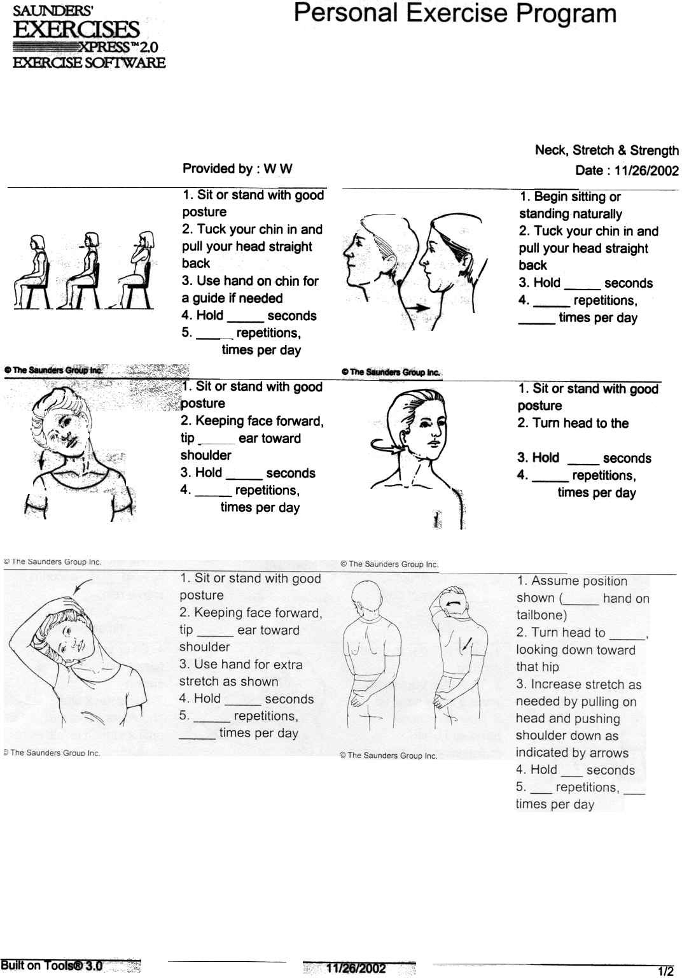
Chin Tucks
Sit or stand in proper posture.
Tuck chin in, pulling head straight back.
Hold for 5 seconds.
Release and repeat 5 times.

Slide 40
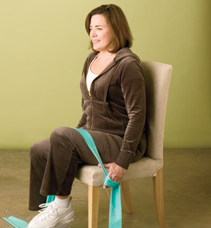
Abdominal Press
Sit in proper posture in a sturdy chair with feet flat on floor.
Engage abdominals and lift one knee.
Place both hands on the lifted knee and press down, resisting with your leg.
Repeat 5 times on each side.

Slide 41
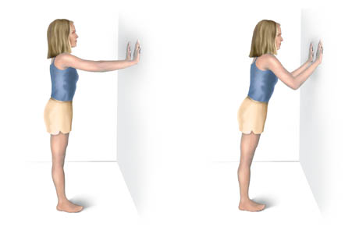
Wall Push-up
Stand in proper posture 30cm away from a wall.
Place both hands on a wall at shoulder height.
Slowly bend your elbows and bring your face toward the wall, moving your hips and shoulders forward together.
Slowly push back to start.
Advance to push-ups on floor.

Slide 42
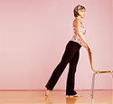
Leg Extension
Stand in proper posture, feet shoulder width apart.
Hold onto a chair or lean against a wall for support, lift one leg behind you, keeping toes and knee facing forwards.
Lower leg and repeat 5 times on each side.

Slide 43
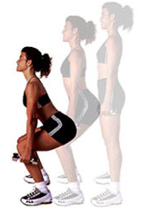
Squats
Stand tall in proper posture, feet shoulder width apart.
Keeping your spine neutral, bend your knees and lower your hips, keeping your knees behind your toes.
Hold for 5 seconds
Slowly return to standing and repeat 5 times.

Slide 44
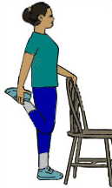
Quad / Hip Stretch
Stand in proper posture in front of a chair or lean against a wall with feet shoulder width apart.
Bend one knee and grasp the top of your foot with one hand, holding for support.
Feel the stretch in the front of your thigh and hip, keeping your bent knee pointing down towards the floor.
Lower leg and repeat on opposite side.

Slide 45
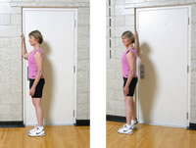
Doorframe Stretch
Stand in proper posture next to a doorframe or sturdy wall.
Raise one elbow to shoulder height and place your forearm flat against the side of the doorframe.
Slowly pivot with your feet, turning away from your raised arm, until you feel a stretch in your chest and shoulder.
Slowly return to starting position and repeat on opposite side.

Slide 46
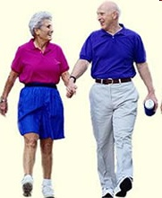
Aerobic Exercises
Walking
Jogging
Swimming
Cycling
Fitness Classes
Dancing
Aim for 30 minutes total on most days of the week.
Target heart rate of 60-80%.

Slide 47
Goals of Exercise
Prevent debilitation caused by inactivity.
Improve tolerance to exercise.
Increase strength.
Reduce pain.
Strength, flexibility and aerobic training should be started within 2 weeks of onset of low back pain:
Delay exercise for the hip and back muscles and gradually incorporate.

Slide 48
Benefits of Exercise
Exercise can help to:
Improve function.
Control weight and reduce body fat.
Promote proper posture
Create feeling of well being.
Decrease swelling and pain.
Increase flexibility and strength.
Decreased fatigue and stress.

Slide 49
Thank you
Copyright Achieva Health

