Slide 1
Strategic Plan
2023-2025

Slide 2
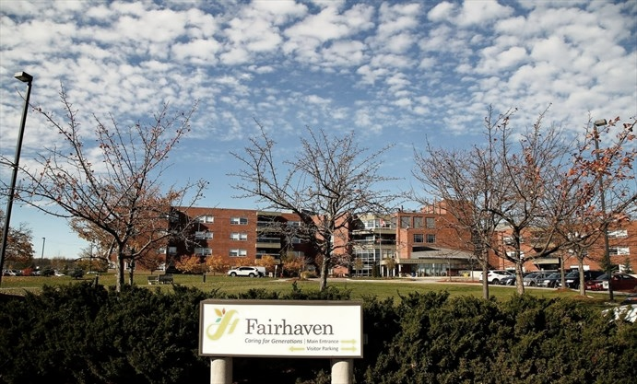
Executive Summary
Fairhaven is owned and operated by the city and county of Peterborough, Ontario. Since its inception in 196o, the home has committed to providing high quality and compassionate care to our diverse and expanding resident population.
In 2003, Fairhaven relocated to its current location at 881 Dutton Road, where the 2355 resident to reside in the home was admitted.
Fairhaven’s services are designed to respond to the needs of each individual resident. Varying degrees of assistance, support and services are available to our residents to ensure that Fairhaven meets their needs while, at the same time, encouraging their individuality and independence.

Slide 3
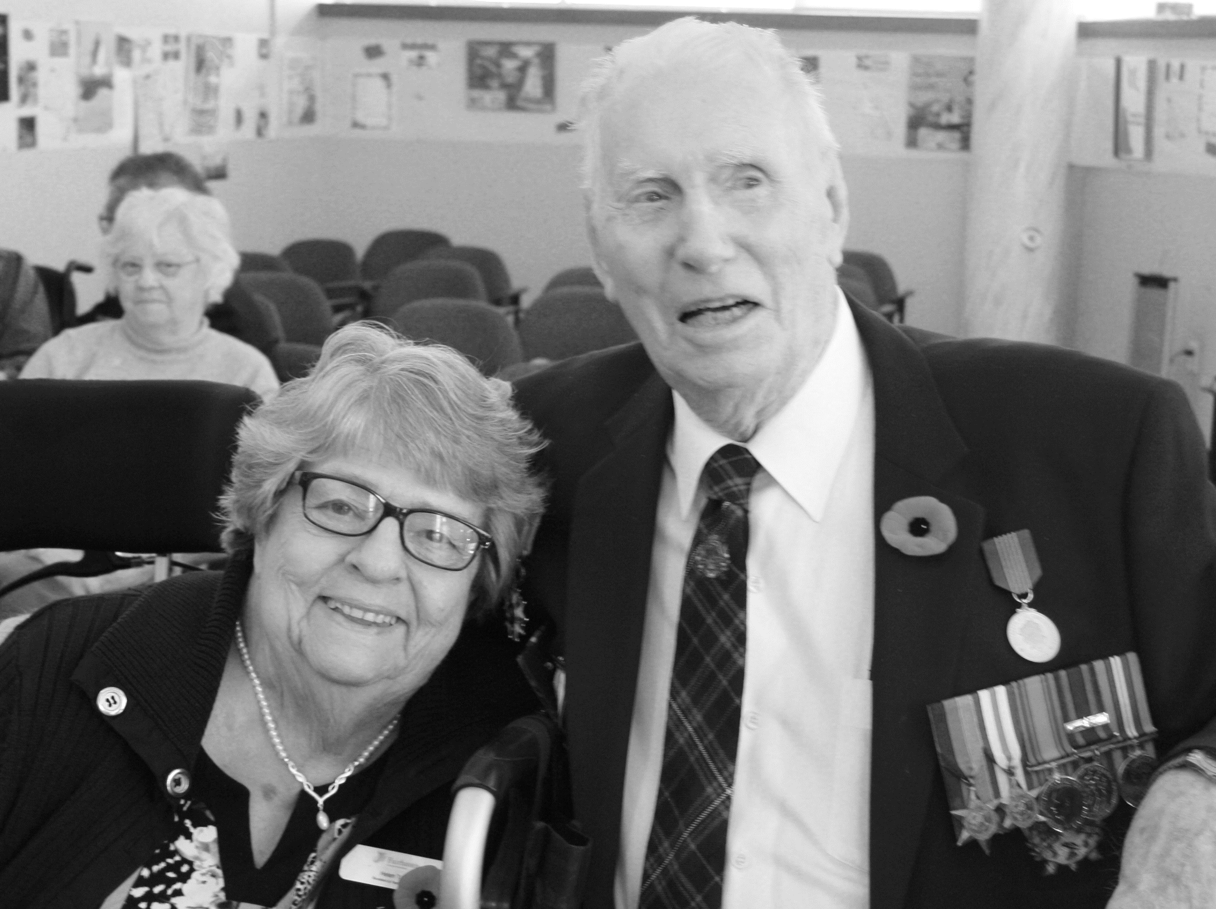
Mission
Dedicated to providing enriched care in a safe and inclusive environment.
Vision
Recognized as a leader in quality resident-focused care through integration and innovation within our community.
Values
Resident Focused, Safety, Transparency, Integrity, Inclusivity, Respect

Slide 4
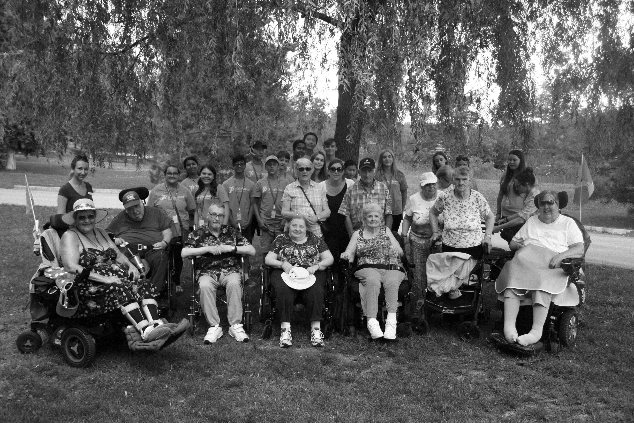
Strategic Directions
Provide High Quality Compassionate Care
Fairhaven is focused on enhancing resident care and providing resident focused solutions through advancing communication, participation and inclusivity among our community.
By a successful delivery of operational plans and monitoring of the internal responsibility system, we will keep the safety of the resident at the core of all decision-making.
Promoting a healthy and safe work environment fosters resident well being. Emphasis on employee recognition and wellness, through new initiatives such as the Wellness Committee, will show improvement in a work safe culture.

Slide 5
Strategic Directions
Enhance Continuous Quality Improvement Efforts
Ensuring adequate funding for operations and capital upgrades to optimize a financial position to support growth and change.
Research funding opportunities and innovations to implement in the home. Proposing a solutions-oriented approach to senior government officials to manage the increasing complexity of resident care.
Advancing best practices and meeting quality standards by harnessing performance metrics to guide programs.

Slide 6
Strategic Directions
Optimizing Human Resources
Invest in staff development through an enhanced training and development program.
Strive to be the Employer of Choice, by supporting, engaging and enriching the lives of our staff working at Fairhaven.
Observing and responding to the needs and challenges of staff to maintain a safe, supportive and inclusive work environment.

Slide 7
Strategic Planning Collaborators and Consultants
Committee of Management
Keith Riel
Dave Haacke
Carol Armstrong
Karl Moher
Trang (Tia) Nguyen
Pat Wilford
John Poch
Community Partners
MOLTC
Accreditation Canada
Leadership Team
Frontline staff
Interdisciplinary Departments
Resident Council
Family Council
Resident, Family and Staff Satisfaction Surveys
SWOT Analysis

